Slide 1
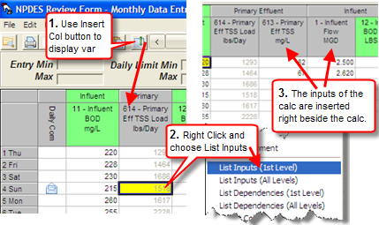
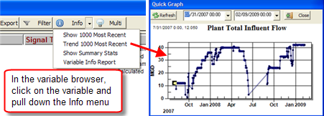
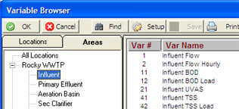
Troubleshooting calculations: Use monthly data entry, insert the calculated variable and use List Inputs: Video: http://www.opssys.com/instantkb/article.aspx?id=10398
Copy Special/Paste Special in Design: Use [F5] Copy Special and [F6] Paste Special in Spread Report and Custom Data Entry Design to copy formulas and format:
Video: http://www.opssys.com/instantkb/article.aspx?id=11455
Setup Areas/locations and assign variables to locations:
1. Use System Setup, System Tables, This Facility, Area Setup to add areas.
2. Use System Setup, Location Setup and add Locations and assign Location:
3. Use System Setup, Edit/View Variables and assign variable to location.
4. Variable Browser is now organized in a tree view:
Video: http://www.opssys.com/instantkb/article.aspx?id=10579
Use Variable Browser Info button: Quickly find data using Quick Trend, Show 1000 most recent, etc…:
Video: http://www.opssys.com/instantkb/article.aspx?id=10579

Slide 2
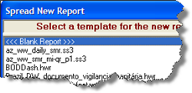
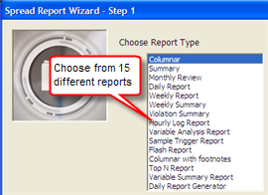
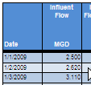
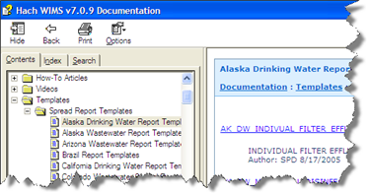
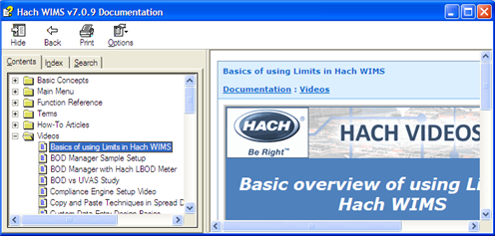
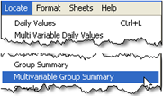
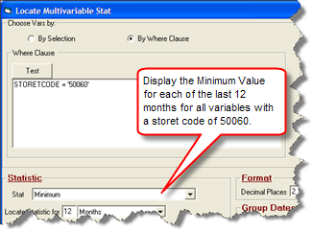
Find your templates: In Spread Design, use File, New to see templates you have loaded: To add to that list, use F1 – Help and browse to Templates, Spread Report Templates and download directly from the help file.
Design reports quickly with the Report Wizard:
Video: http://www.opssys.com/instantkb/article.aspx?id=11464
http://www.opssys.com/instantkb/article.aspx?id=11465
Videos: Press F1-Help and browse to videos:
Use Locate Multi Variable Group Summary:
Need the max value from all your filter variables:
Support: Call 800-677-0067, email iimsupport@hach.com

